Slide 1
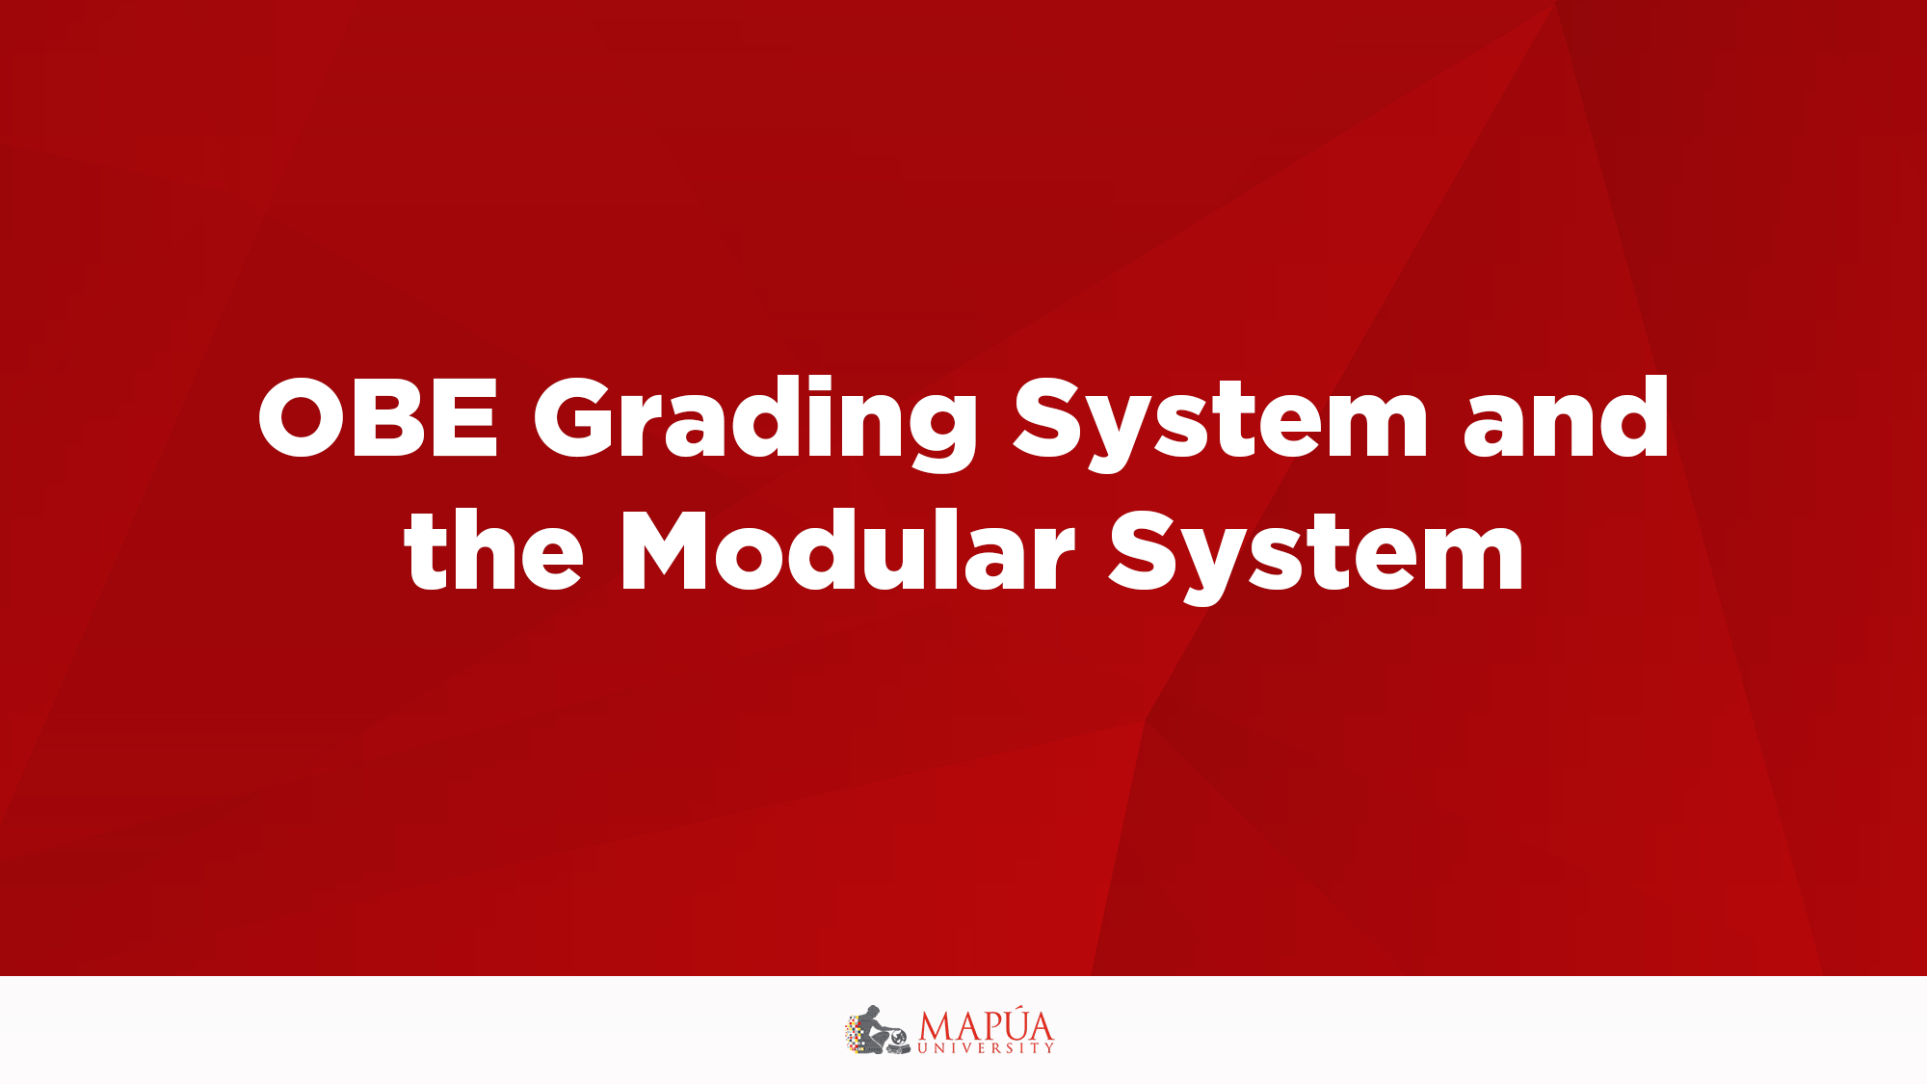
Selection/Conditional Structure

Slide 2

Relational Operators
A condition is represented by a logical (Boolean) expression that can be true or false
Relational operators:
  Allow comparisons
  Require two operands (binary)
  Evaluate to true or false

Slide 3
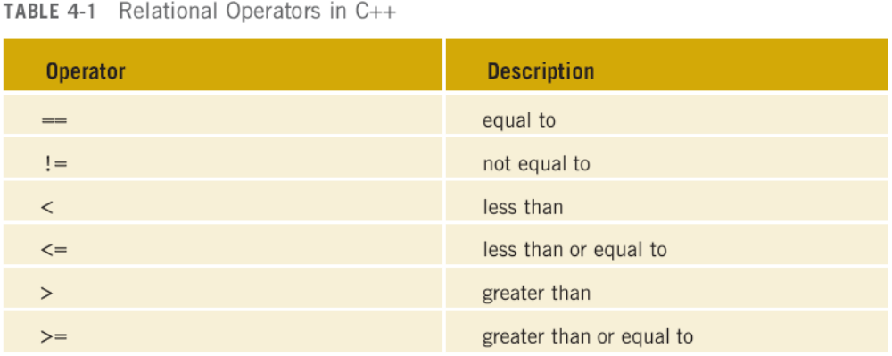
Relational Operators (cont'd.)

Slide 4
Relational Operators and Simple Data Types
You can use the relational operators with all three simple data types:
  6 < 10 evaluates to true
  8 != 8 evaluates to false
  3.7 > 10.8 evaluates to false
  1.7 <= 9.2 evaluates to true

Slide 5
Comparing Characters
Expression with relational operators
  Depends on machine’s collating sequence
  ASCII character set
Logical (Boolean) expressions
  Expressions such as 7 < 9 and ‘C' > ‘A’
  Returns an integer value of 1 if the logical expression evaluates to true
  Returns an integer value of 0 otherwise

Slide 6
Relational Operators and the string Type
Relational operators can be applied to strings
Strings are compared character by character, starting with the first character
Comparison continues until either a mismatch is found or all characters are found equal
If two strings of different lengths are compared and the comparison is equal to the last character of the shorter string
  The shorter string is less than the larger string

Slide 7
Relational Operators and the string Type
Suppose we have the following declarations:
  string str1 = "Hello";
  string str2 = "Hi";
  string str3 = "Air";
  string str4 = "Bill";
  string str5 = "Big";

Slide 8
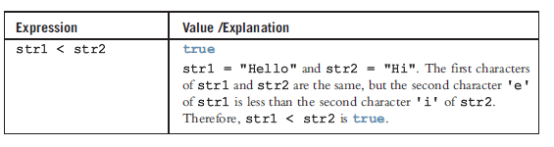
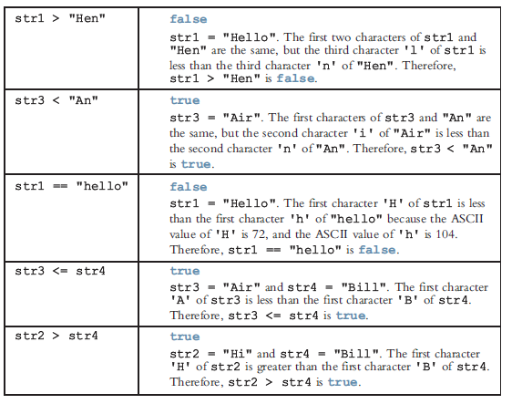
Relational Operators and the string Type

Slide 9
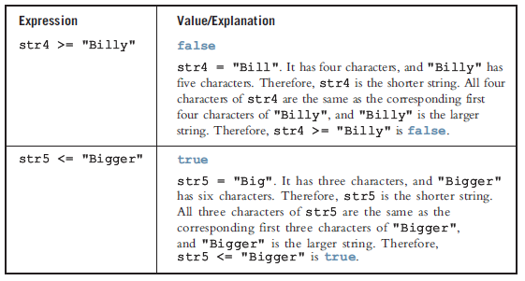
Relational Operators and the string Type

Slide 10
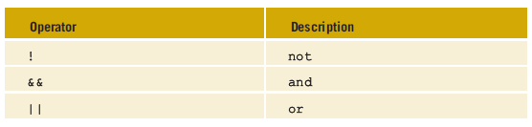
Logical (Boolean) Operators and Logical Expressions
Logical (Boolean) operators enable you to combine logical expressions

Slide 11
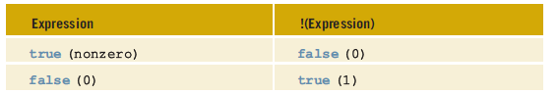
Logical (Boolean) Operators and Logical Expressions
NOT Operator (!)

Slide 12
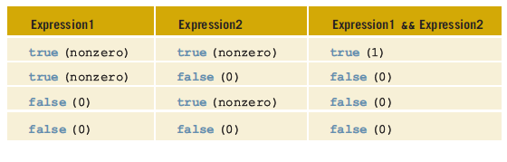
Logical (Boolean) Operators and Logical Expressions
AND Operator (&&)

Slide 13
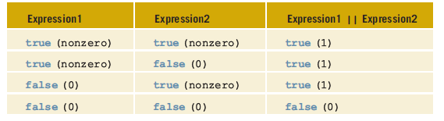
Logical (Boolean) Operators and Logical Expressions
OR Operator (||)

Slide 14
Order of Precedence
Relational and logical operators are evaluated from left to right
The associativity is left to right
Parentheses can override precedence

Slide 15
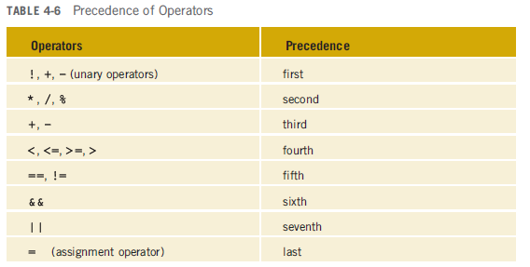
Order of Precedence

Slide 16
int Data Type and Logical (Boolean) Expressions
Earlier versions of C++ did not provide built-in data types that had Boolean values
Logical expressions evaluate to either 1 or 0
  The value of a logical expression was stored in a variable of the data type int
You can use the int data type to manipulate logical (Boolean) expressions

Slide 17
The bool Data Type and Logical (Boolean) Expressions
The data type bool has logical (Boolean) values true and false
bool, true, and false are reserved words
The identifier true has the value 1
The identifier false has the value 0

Slide 18
Selection: if and if...else
One-Way Selection
Two-Way Selection
Compound (Block of) Statements
Multiple Selections: Nested if
Comparing if...else Statements with a Series of if Statements

Slide 19
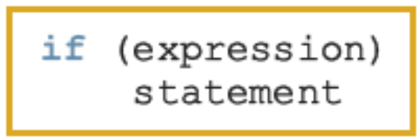
One-Way Selection
The syntax of one-way selection is:
The statement is executed if the value of the expression is true
The statement is bypassed if the value is false; program goes to the next statement
if is a reserved word

Slide 20
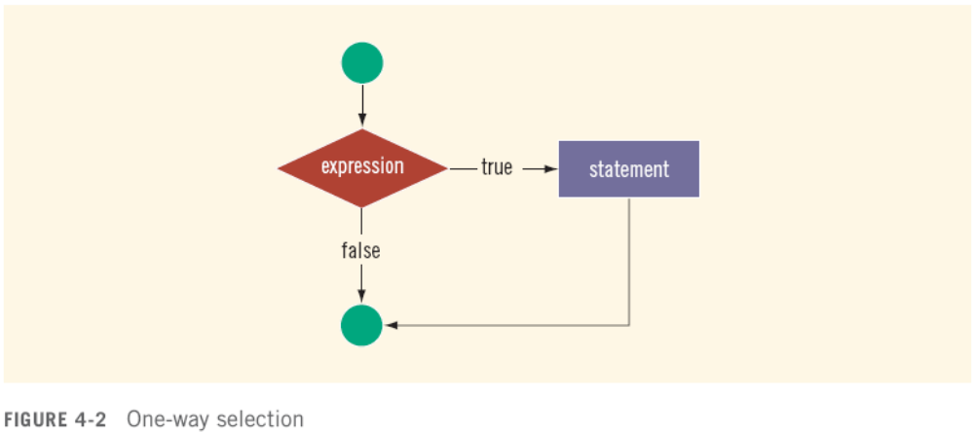
One-Way Selection (cont'd.)

Slide 21
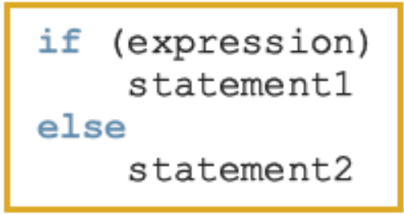
Two-Way Selection
Two-way selection takes the form:
If expression is true, statement1 is executed; otherwise, statement2 is executed
  statement1 and statement2 are any C++ statements
else is a reserved word

Slide 22
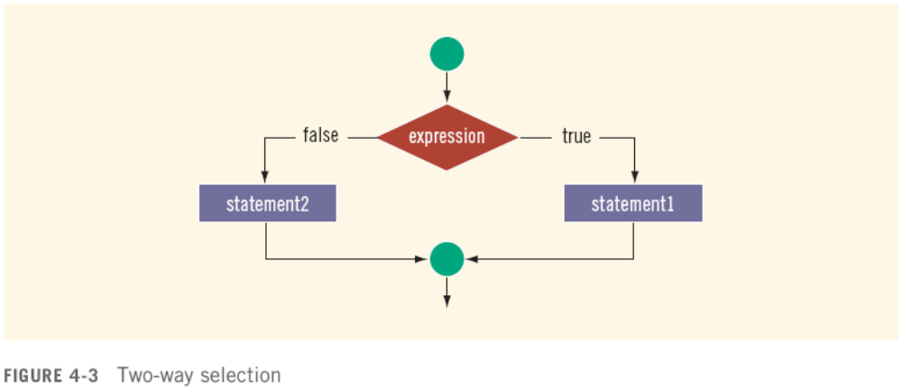
Two-Way Selection (cont'd.)

Slide 23
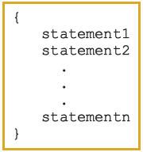
Compound (Block of) Statements
Compound statement (block of statements):
A compound statement is a single statement

Slide 24
Multiple Selections: Nested if
Nesting: one control statement in another
An else is associated with the most recent if that has not been paired with an else

Slide 25
Avoiding Bugs by Avoiding Partially Understood Concepts and Techniques
Must use concepts and techniques correctly;
  Otherwise solution will be either incorrect or deficient
If you do not understand a concept or technique completely
  Don’t use it
  Save yourself an enormous amount of debugging time

Slide 26
Input Failure and the if Statement
If input stream enters a fail state
  All subsequent input statements associated with that stream are ignored
  Program continues to execute
  May produce erroneous results
Can use if statements to check status of input stream
If stream enters the fail state, include instructions that stop program execution

Slide 27
Confusion Between the Equality (==) and Assignment (=) Operators
C++ allows you to use any expression that can be evaluated to either true or false as an expression in the if statement:
  if (x = 10)
  cout << "The value is five." << endl;
The appearance of = in place of == resembles a silent killer
  It is not a syntax error
  It is a logical error

Slide 28
Conditional Operator (?:)
Conditional operator (?:) takes three arguments
  Ternary operator
Syntax for using the conditional operator:
expression1 ? expression2 : expression3
If expression1 is true, the result of the conditional expression is expression2
  Otherwise, the result is expression3

Slide 29
Program Style and For: Indentation
If your program is properly indented
  Spot and fix errors quickly
  Show the natural grouping of statements
Insert a blank line between statements that are naturally separate
Two commonly used styles for placing braces
  On a line by themselves
  Or left brace is placed after the expression, and the right brace is on a line by itself

Slide 30
Using Pseudocode to Develop, Test, and Debug a Program
Pseudocode, or just pseudo
  Informal mixture of C++ and ordinary language
  Helps you quickly develop the correct structure of the program and avoid making common errors
Use a wide range of values in a walk-through to evaluate the program

Slide 31
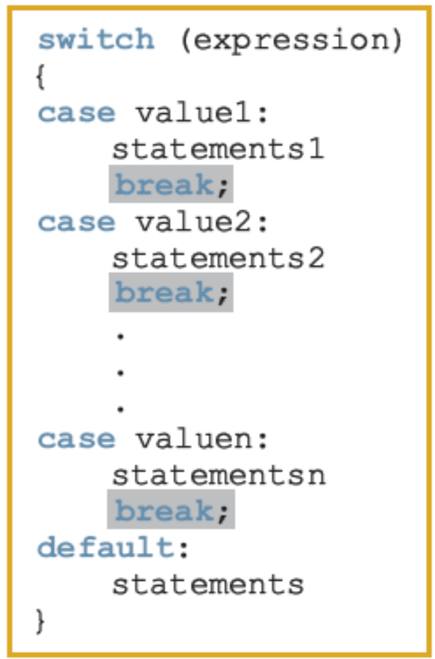
switch Structures
switch structure: alternate to if-else
switch (integral) expression is evaluated first
Value of the expression determines which corresponding action is taken
Expression is sometimes called the selector

Slide 32
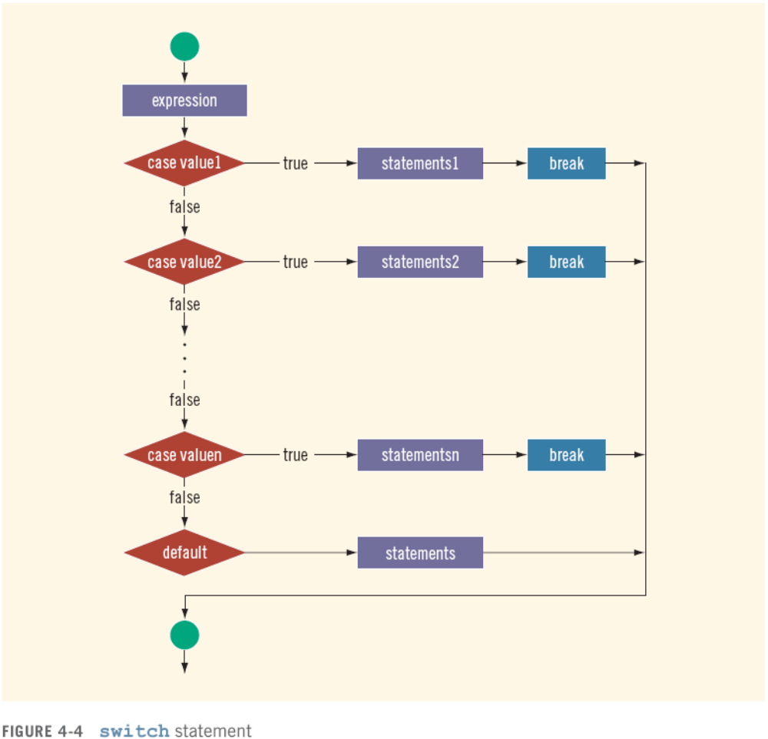
switch Structures (cont'd.)

Slide 33
switch Structures (cont'd.)
One or more statements may follow a case label
Braces are not needed to turn multiple statements into a single compound statement
The break statement may or may not appear after each statement
switch, case, break, and default are reserved words

Slide 34
Avoiding Bugs by Avoiding Partially Understood Concepts and Techniques: Revisited
To output results correctly
  The switch structure must include a break statement after each cout statement
C++ Programming: From Problem Analysis to Program Design, Fifth Edition

Slide 35


